Slide 1
Server Operating System Installation
From bare hardware to a production-ready server

Slide 2
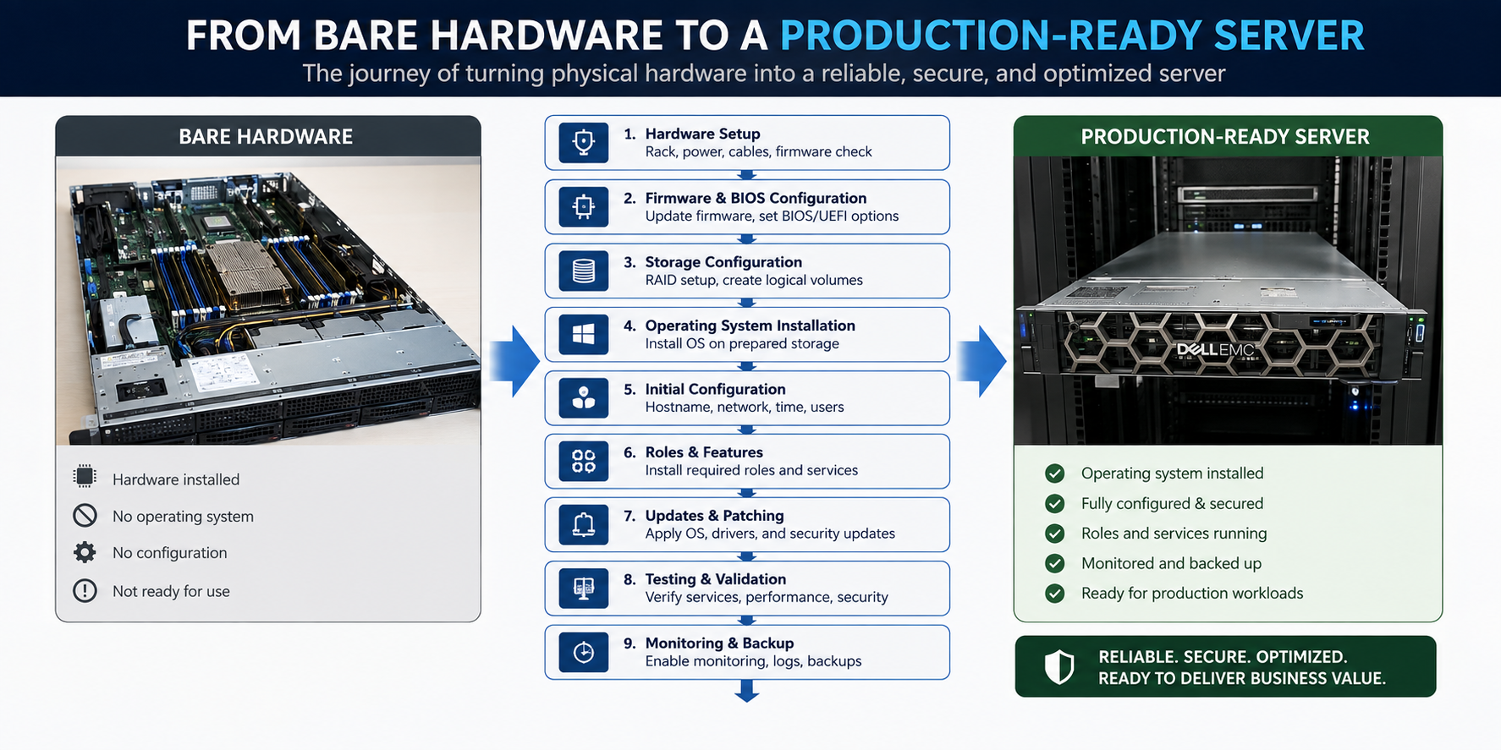

Slide 3





Server Configuration
STEP 01
STEP 02
STEP 03
STEP 04
STEP 05
Admin Login
System Basics
Networking
Patching
Storage
Administrator access.
Hostname & time setup.
Static IP & DNS.
Drivers & updates.
Partitions & volumes.
STEP 06
STEP 07
STEP 08
STEP 09
STEP 10
Services
Security
Identity
Testing
Monitoring
Enable required roles.
Firewall & hardening.
Users & permissions.
Verify connectivity.
Backup & telemetry.

Slide 4
The Server Deployment Journey
Hardware
Firmware
BIOS / UEFI
Storage
Operating System
Network + Identity
Roles + Applications
Testing + Monitoring

Slide 5

Before Installation
Know the Hardware before installing anything:
CPU & Memory
How much processing power and RAM do we need?
Storage & RAID
How much storage do we need, and what RAID level is appropriate?
Network Adapters
How many network adapters are needed, and what will each one be used for?
Management Controller
How will we remotely manage the server if the OS is unavailable?
Supported Operating Systems
Which OS versions are officially supported by this hardware?

Slide 6
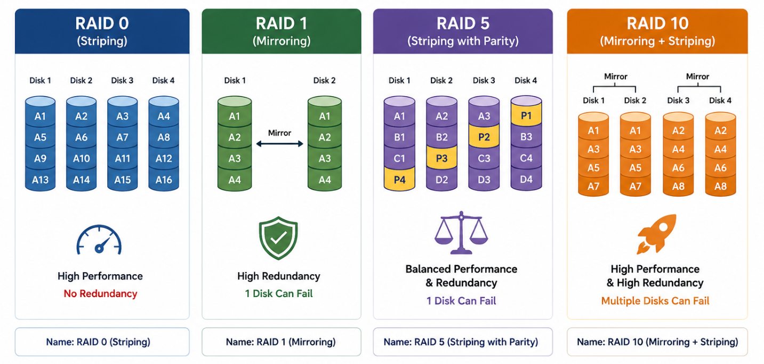

Slide 7
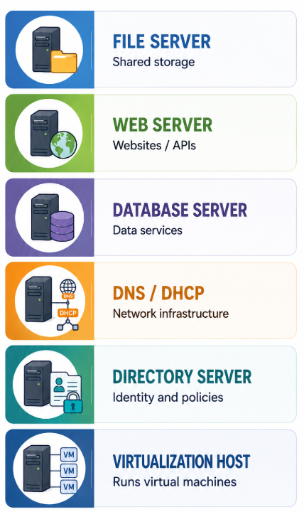
Server Role Identification
The role determines the requirements.
  File Server — Shared storage
  Web Server — Websites / APIs
  Database Server — Data services
  DNS / DHCP — Network infrastructure
  Directory Server — Identity and policies
  Virtualization Host — Runs virtual machines

Slide 8
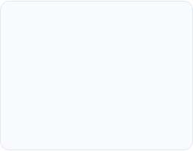

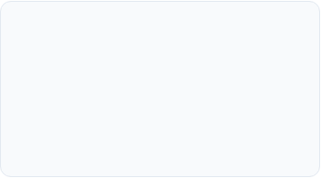
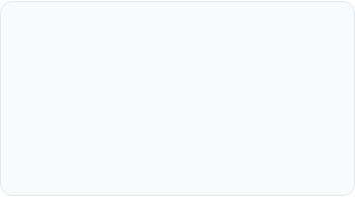
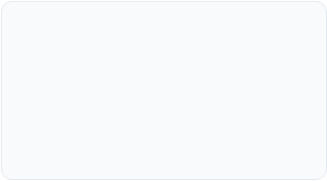


Server Role and Feature Configuration Process
Identify Needs
Install Roles
Configure Core
Network Setup
Web hosting, DNS, DHCP, and database services.
Minimal OS feature and service role installation.
Set active parameters, IP bindings, and directories.
Assign local IPs, DNS, and primary firewall rules.
Apply Security
Start & Test
Monitor Health
Strong authentication and least-privilege access enforcement.
Verify active services and incoming client connections.
Track CPU, RAM usage, system logs, and updates.

Slide 9

Firmware
Low-level firmware: Usually stored in non-volatile memory chips like read-only memory (ROM)
High-level firmware: This deployed within flash memory chips and comes with more complex instructions
Subsystems: operates semi-independently within larger embedded systems and is often updatable.
Firmware Can Include (Depending on the server hardware):
  BIOS (Basic Input/Output System) / UEFI (Unified Extensible Firmware Interface)
  RAID Controller
  Network Adapters
  Management Controller
  Drive Firmware

Slide 10
UEFI Frimware
The OS Components
  Boot Mode / Boot Order
  Secure Boot
  CPU Virtualization
  Storage Controller/ Raid
  TPM / Security Settings
  PXE / Network Boot
  ECC Memory

Slide 11
Storage Preparation
From Physical Disks to Usable Storage
Physical Disks
RAID / Storage Configuration
Volumes / Partitions
File System
OS + Applications + Data
What should we consider?
  Capacity
  Performance
  Redundancy
  Future Growth
  Backup

Slide 12
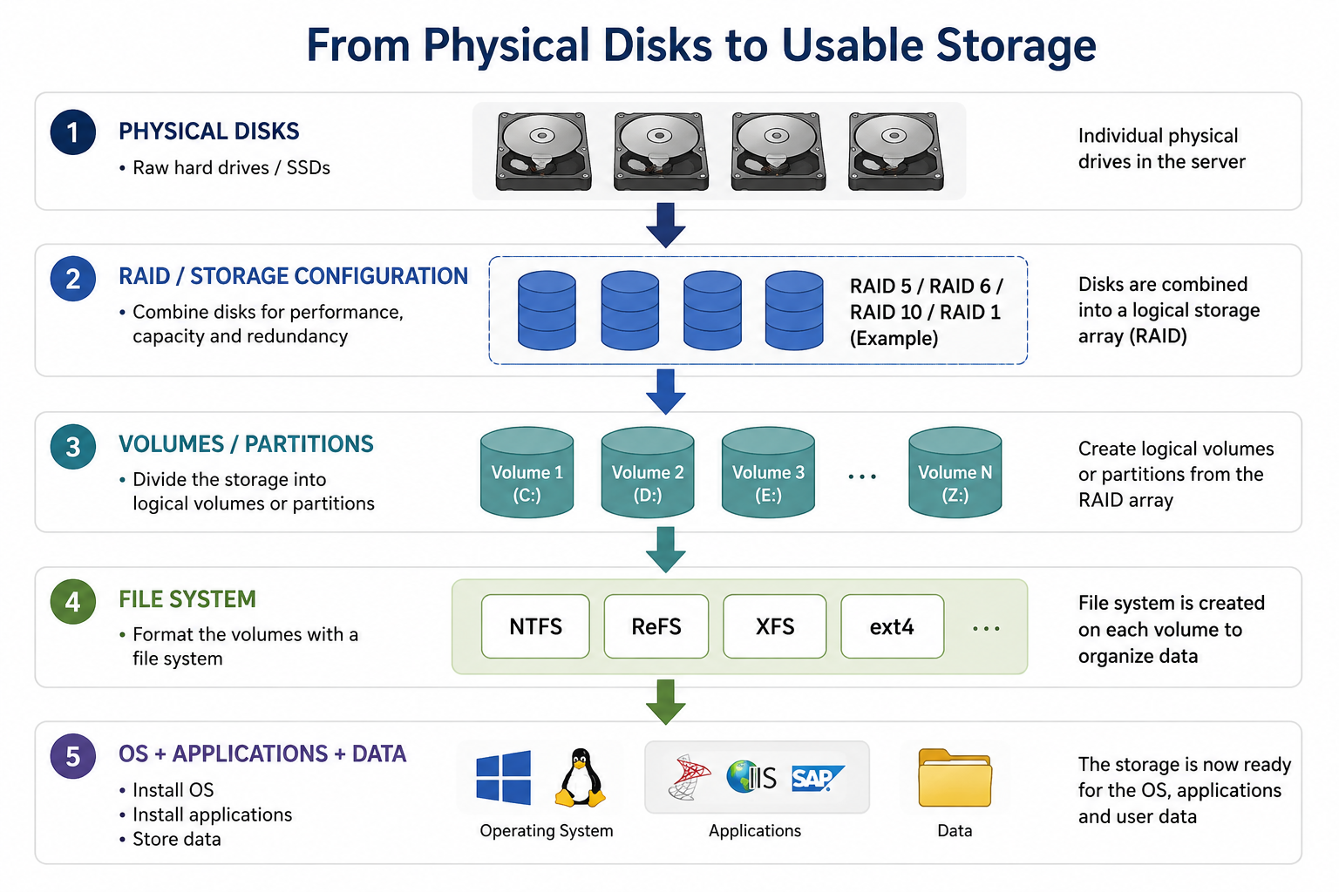

Slide 13
Operating System Installation
Basic Installation Process
  Boot installation media
  Select OS / Edition
  Select storage
  Create partitions
  Install OS
  Complete initial setup
  Reboot
  Apply updates
Common Server OS:
  Windows Server
  Ubuntu Server
  RHEL
  SUSE

Slide 14
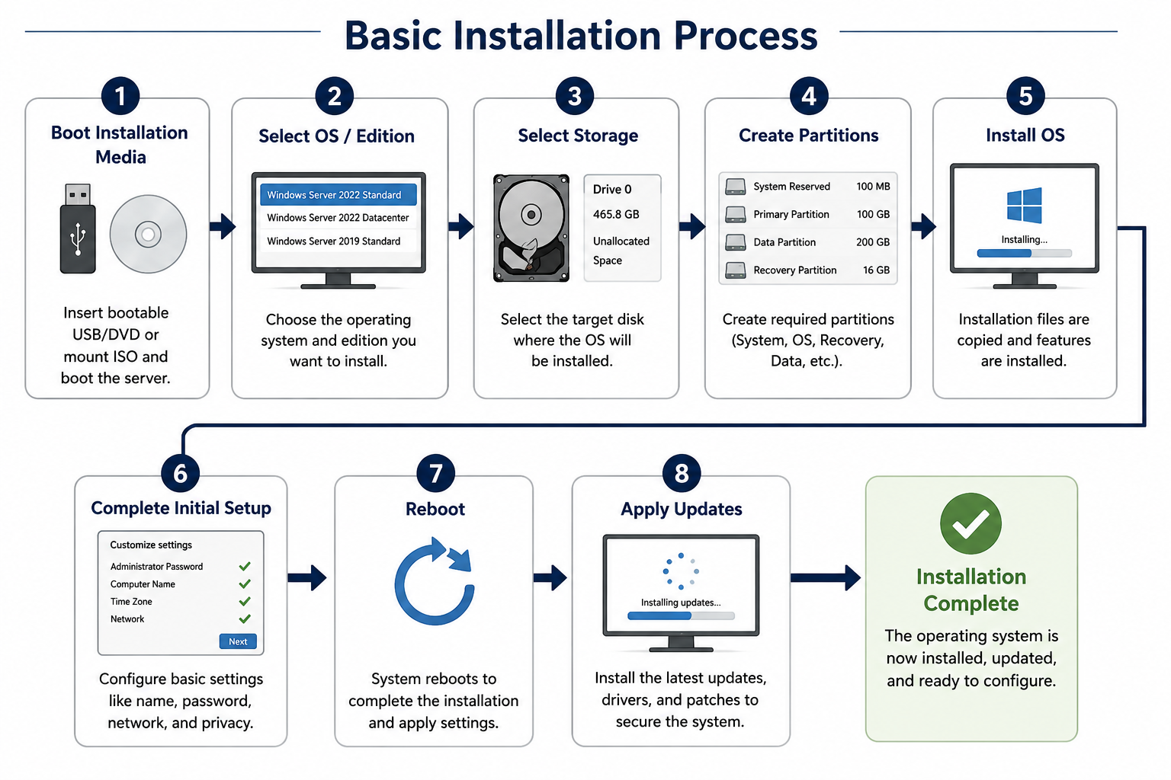

Slide 15

First Configuration
Three questions every new server should answer
  WHO AM I?
    Hostname
    Example: APP-SRV-01
  WHERE AM I?
    IP Address
    Subnet
    Gateway
    DNS
  WHO CAN MANAGE ME?
    Secure credentials
    Least privilege
    Required accounts only

Slide 16
What is a Hostname?
A hostname is a unique name assigned to a server to identify it on a network.
Characteristics of a Good Hostname
  Unique and meaningful
  Easy to remember and identify
  Indicates the server's purpose
  Follows the organization's naming convention
Examples
  Hostname Purpose
  WEB-SERVER-01 Web Server
  DB-SERVER-01 Database Server
  FILE-SERVER-01 File Server
Configuration Procedure
  1. Log in → Administrator account
  2. Open Settings → System / Computer Name
  3. Enter Hostname → e.g., WEB-SERVER-01
  4. Save Changes → Apply the new name
  5. Restart → If required
  6. Verify → Use hostname command
  7. Check DNS → Ensure proper network registration

Slide 17
Domain / Directory Joining
Before joining:
After joining:
Server → Organization Directory → Users + Policies + Management
Server → manages itself
Pre-requisites before Joining
DNS must work
Network connectivity must work
Time must be synchronized
Correct credentials are required

Slide 18
Roles, Services & Features
What is the Difference?
  ROLE
    What the server does
    Example: Web Server
  FEATURE
    Additional capability
    Example: Backup feature
  SERVICE
    Background component providing a function
    Example: DNS Service

Slide 19
Drivers, Applications & Updates
Build a stable software stack
Drivers
Storage
Network
Chipset
Management
Applications
Database
Web Backup
Monitoring
Security
Controlled Change Process
Install > Patch > Reboot > Verify > Test

Slide 20
Performance Baseline
What does "normal" look like?
Basic Process

Slide 21
Unattended & Remote Installation

Slide 22
Virtualization
One physical server. Multiple workloads.
Why virtualization?
Better hardware utilization
Workload isolation
Easier deployment
Flexible resource allocation
Simplified management

Slide 23

The Virtualization Model
Physical Server
Hypervisor
Manages virtual machines
Virtual Machines
VM 1 — Web
VM 2 — Database
VM 3 — DNS
CPU | RAM |Storage |NIC

Slide 24
Type 1 vs Type 2 Hypervisors
Type 1 — Bare Metal
VMs > Hypervisor > Hardware
Examples: ESXi, Hyper-V
Type 2 — Hosted
VMs > Hypervisor > Host OS > Hardware
Example: VirtualBox

Slide 25

VM Management
A hypervisor management console can be used to:
  Create / Delete VMs
  Start / Stop VMs
  Allocate CPU and Memory
  Configure Virtual Disks
  Configure Virtual Networking
  Monitor Performance
  Create Snapshots / Checkpoints
  Migrate VMs where supported

Slide 26
Hardware Compatibility List
Supported does not mean "it seems to work"
Why HCL Matters
Stability
Drivers
Performance
Vendor Support
Troubleshooting

Slide 27
VM Resource Allocation
Example Host
16 CPU Cores
64 GB RAM
2 TB Storage
2 × 1 Gb NIC
Example VM Allocation
Web — 2 vCPU — 4 GB RAM
Database — 4 vCPU — 16 GB RAM
DNS — 2 vCPU — 4 GB RAM
Application — 4 vCPU — 16 GB RAM
Resources that must remain available
CPU Headroom
Memory Headroom
Storage I/O
Network Capacity

Slide 28
Deployment Challenge
Hardware
The organization needs
Web Server
Database Server
DNS Server

Slide 29
From Hardware to Production
Deployment Checklist
Identify role
Verify compatibility
Update firmware
Configure BIOS / UEFI
Prepare storage
Install OS
Configure hostname
Configure network
Configure accounts
Join directory
Install roles & features
Install drivers & applications
Patch
Test
Baseline
Document
PLAN → BUILD → CONFIGURE → TEST → MONITOR

